Slide 1
Showcase
Back Buddy

Slide 2


Slide 3
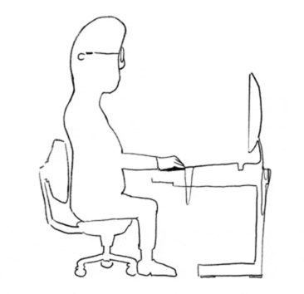
Problem Statement
Over 619 million people worldwide suffer from low back pain, the leading cause of disability globally (WHO). In the U.S., 80% of adults experience back pain, often linked to poor posture from long hours of sitting. Those who sit over 8 hours a day are twice as likely to develop chronic pain (ACA). Despite this, posture awareness tools remain limited and underused.
Our Vision
To create a world where good posture is effortless, accessible, and integrated into everyday life. Back Buddy empowers people to take control of their spinal health through smart, intuitive support

Slide 4
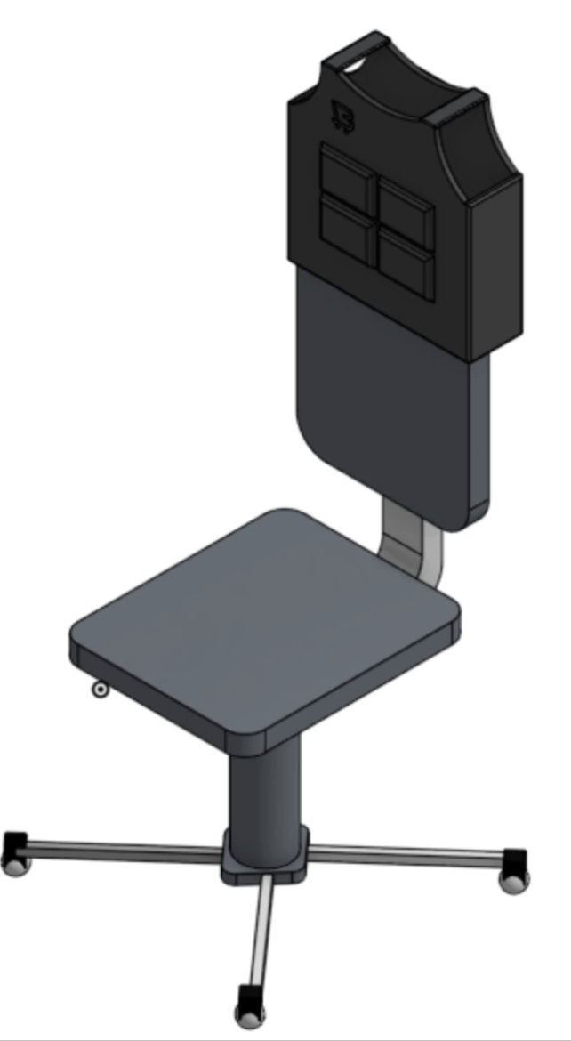
Product Pitch
Portable posture pad that provides instant, adaptable support for maintaining proper posture while seated.
Lightweight, easy to carry, and rechargeable!
Features air cells that inflate in response to pressure sensors, gently pushing the user to adjust their posture and maintain proper spinal alignment.
App that provides progress, control, and allows for setting goals!

Slide 5
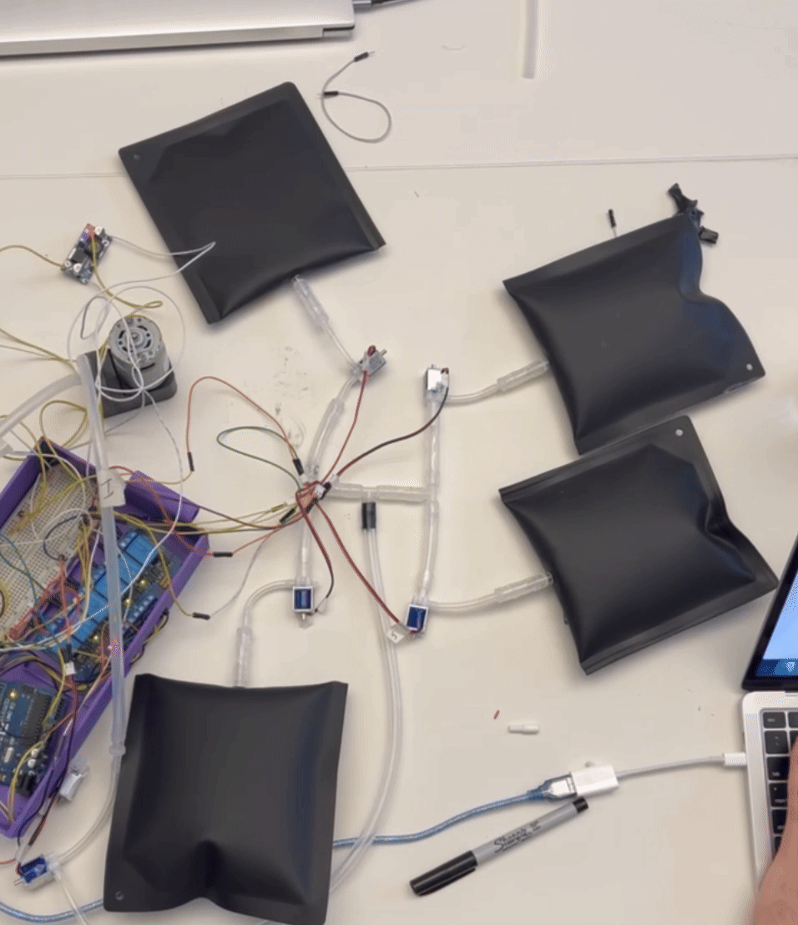
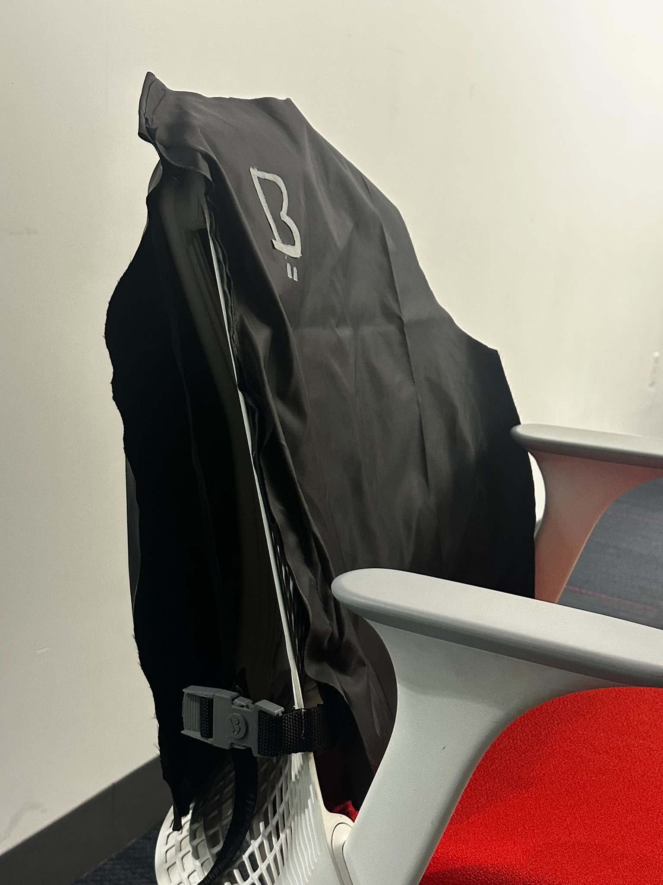
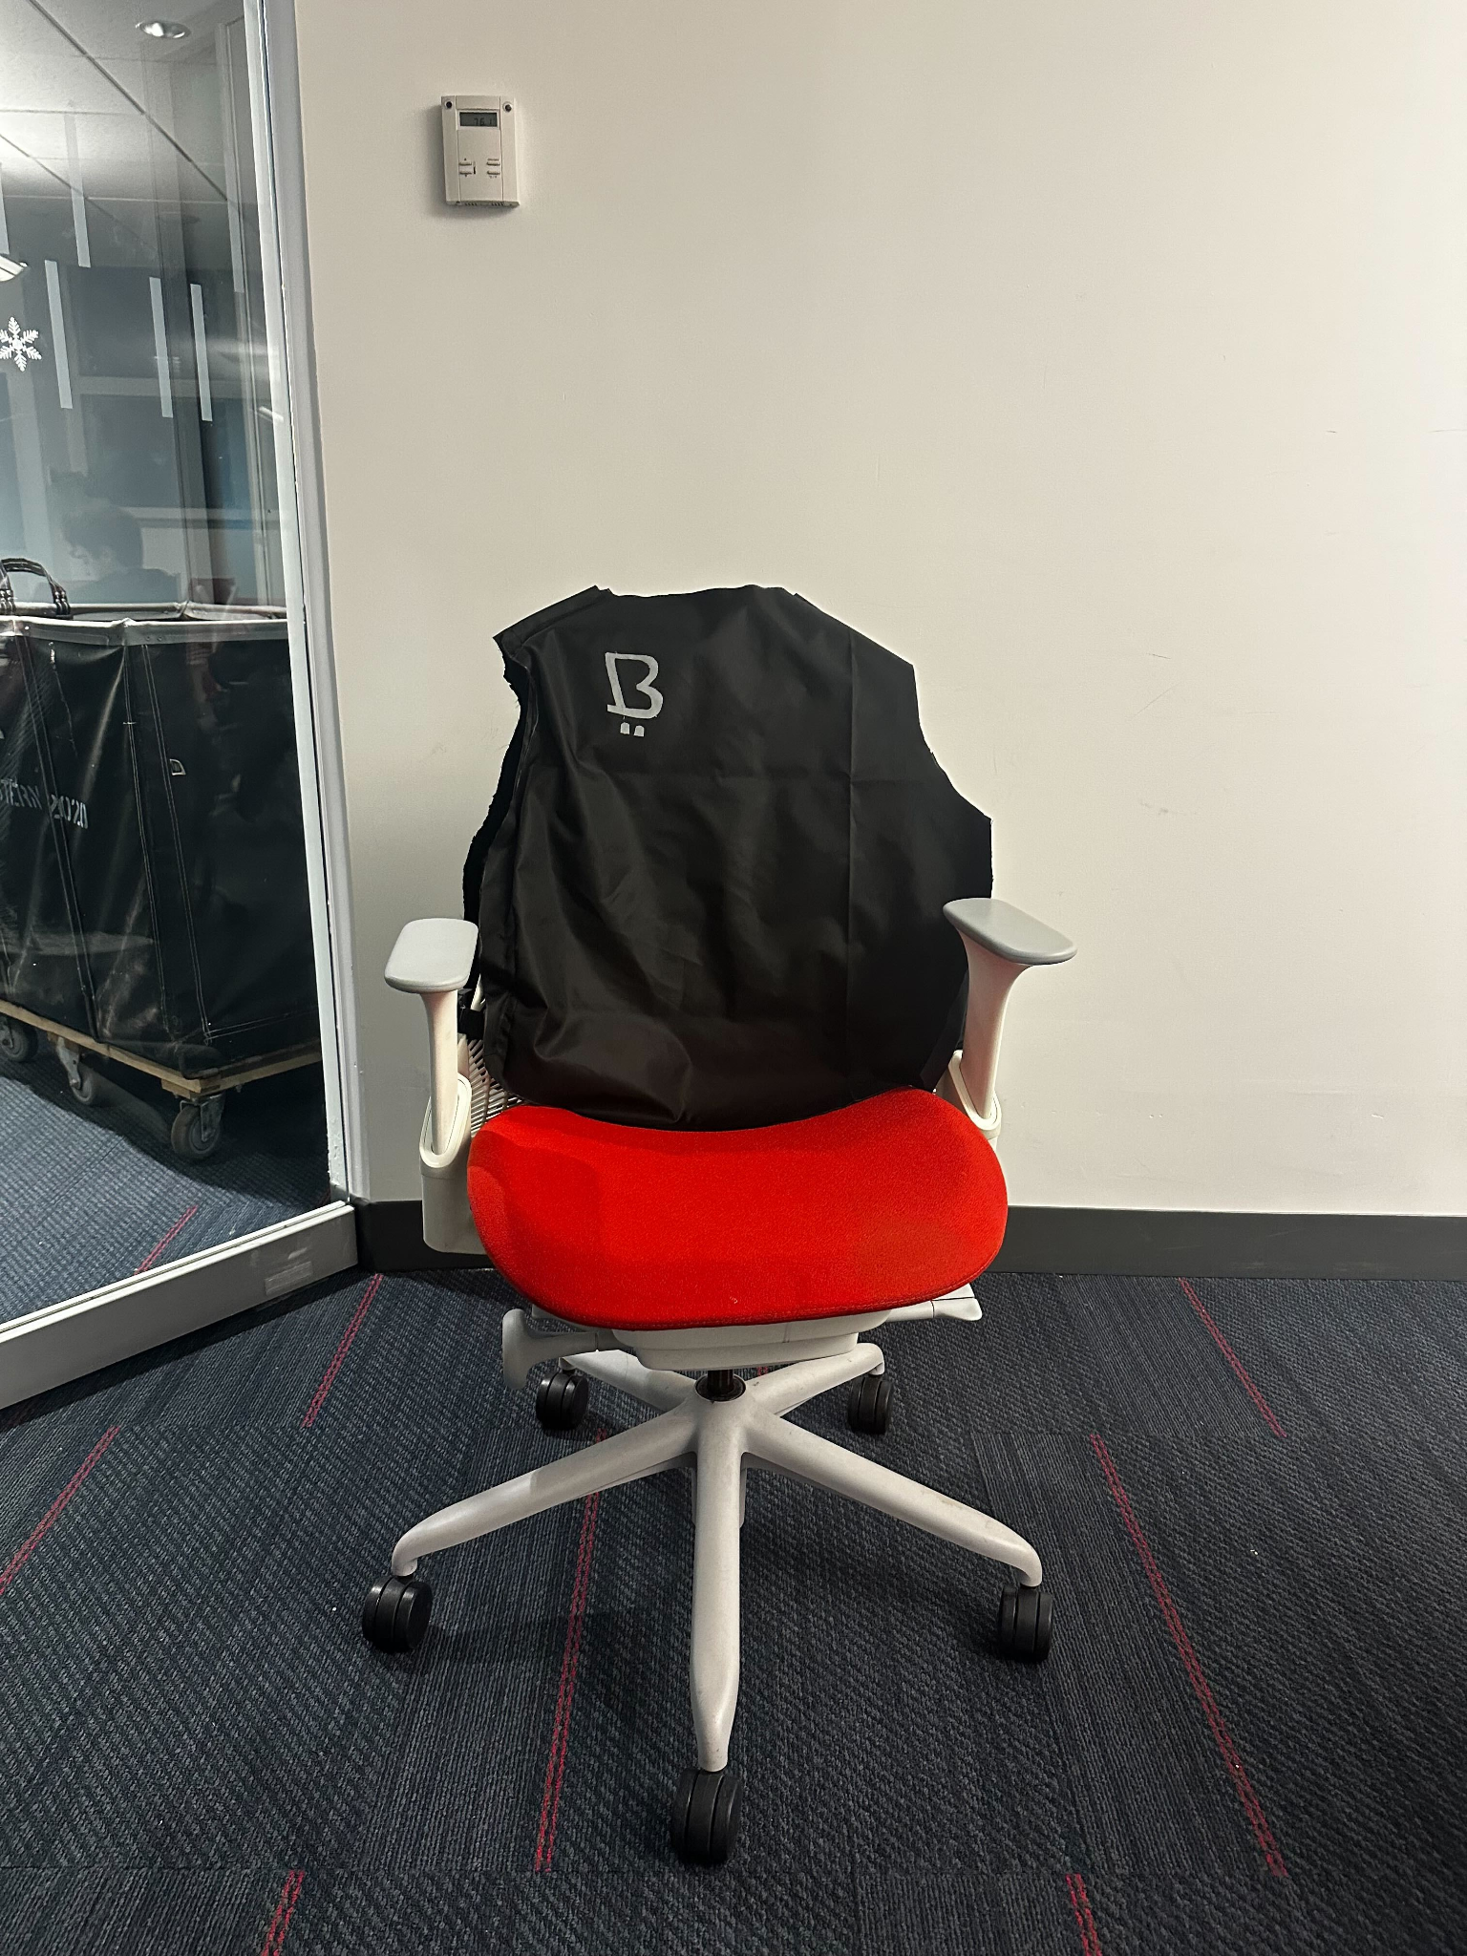
Mechanical Overview - System
Air Cells
Tubing System
Fabric - Nylon Water Repellent

Slide 6
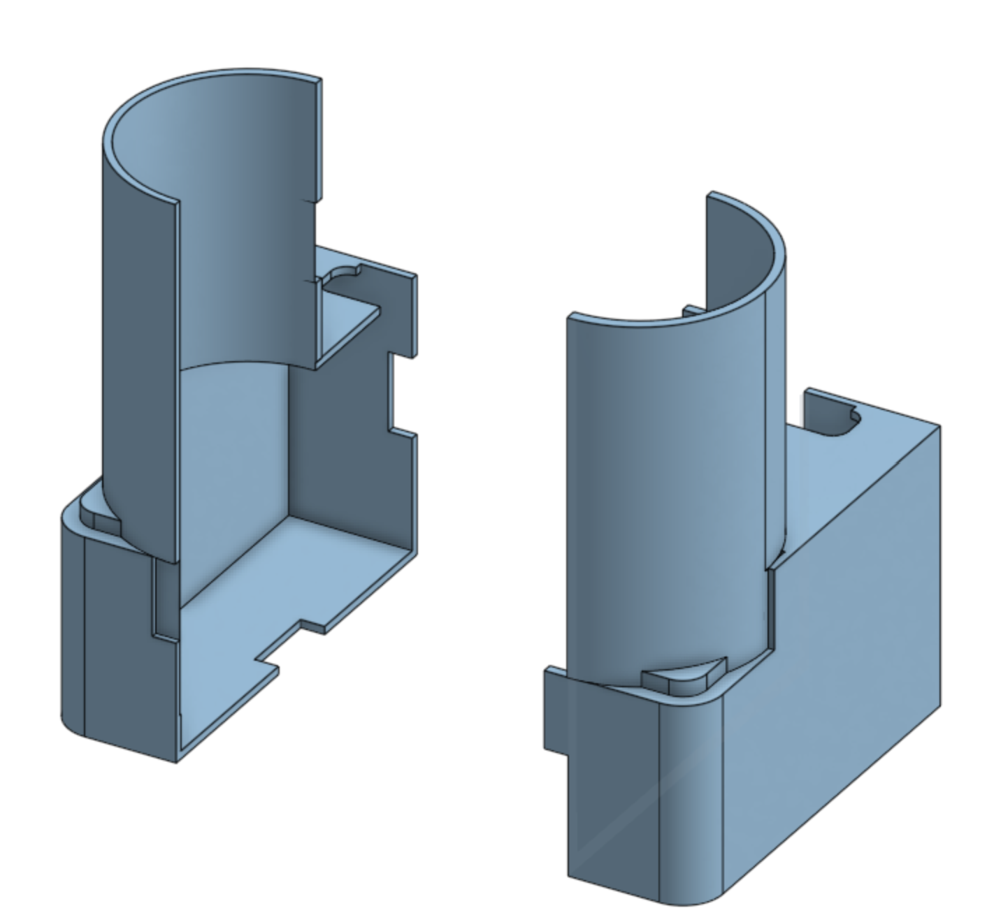
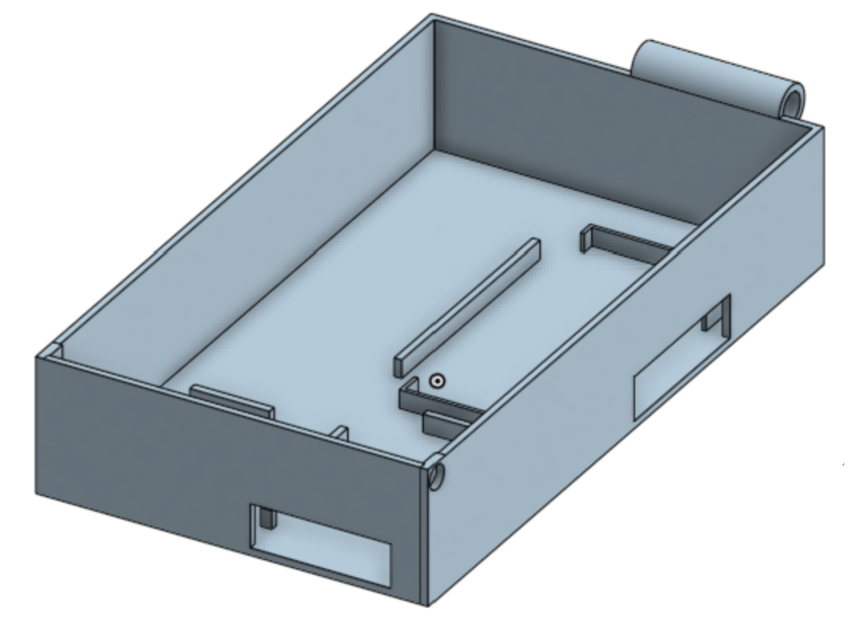
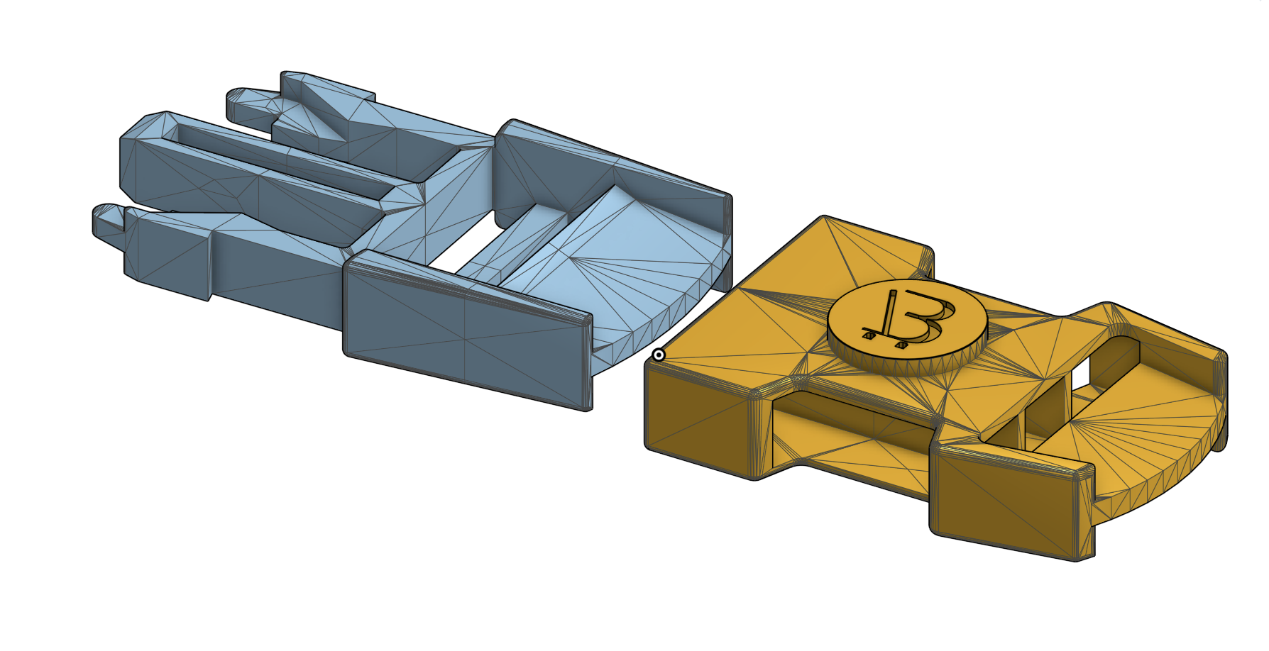
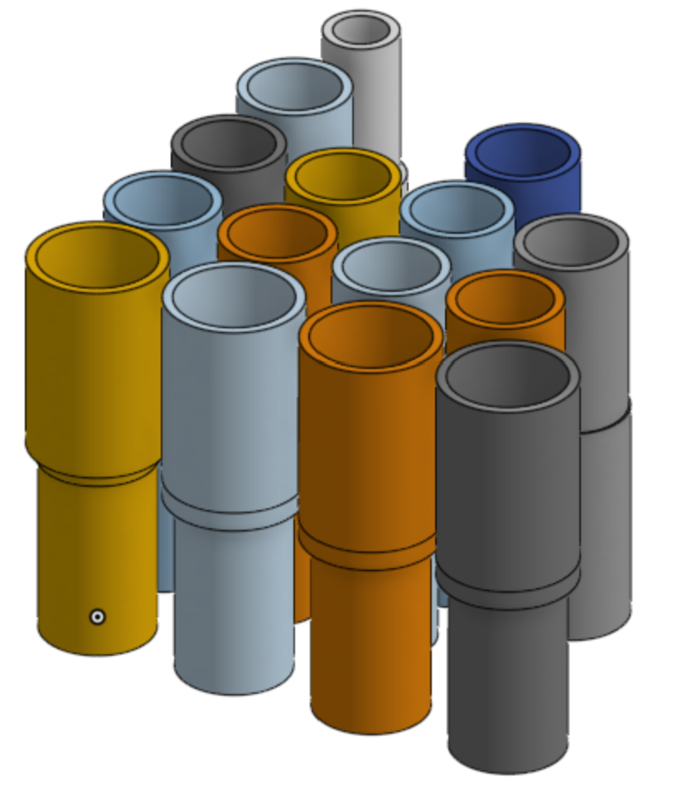
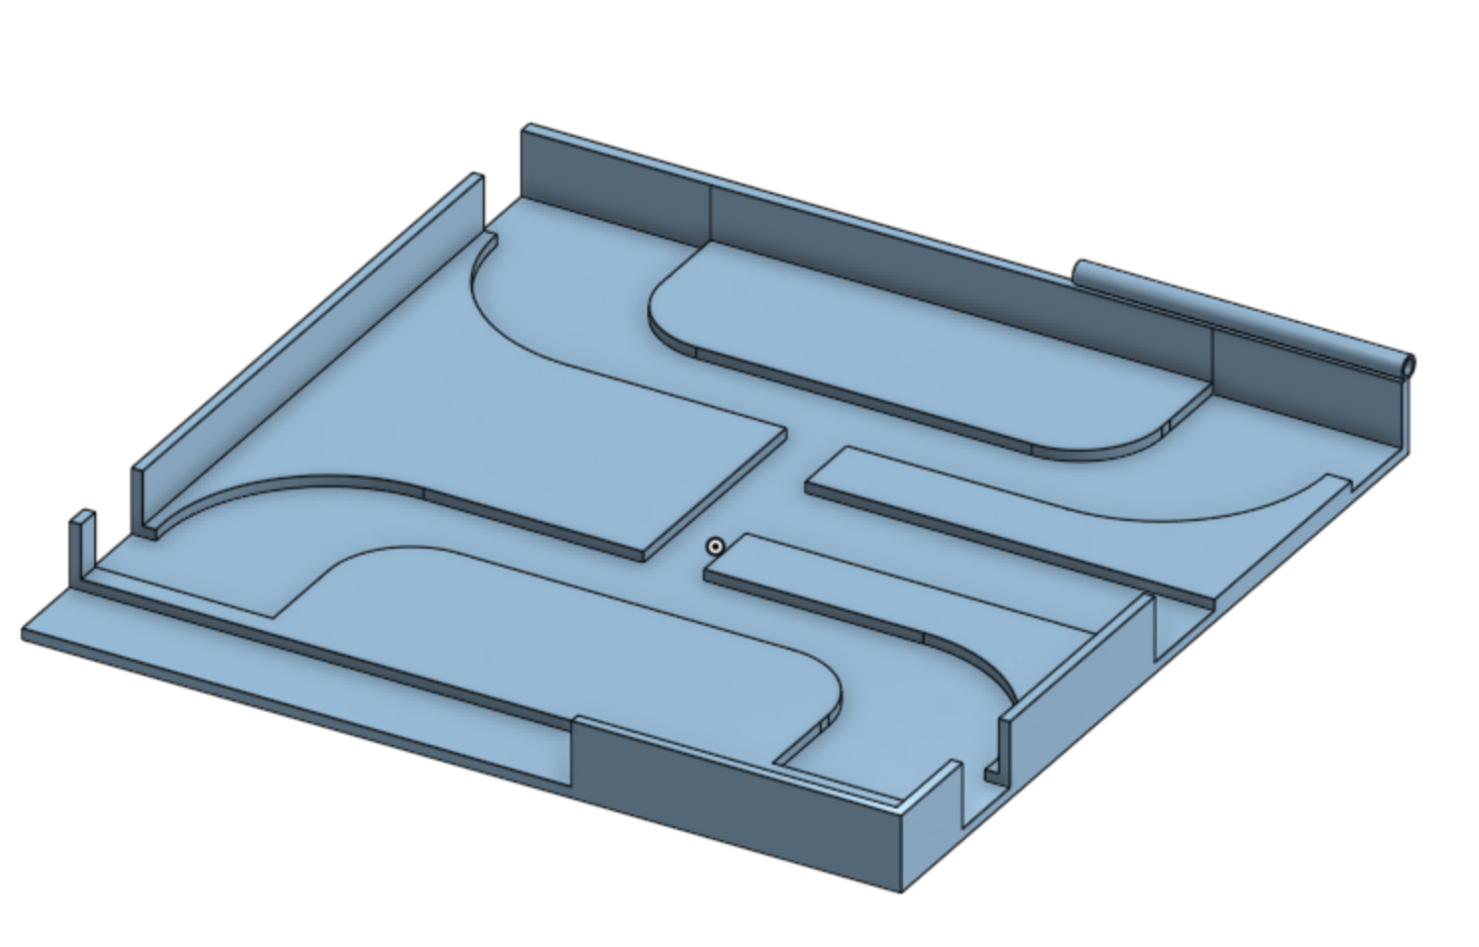
Mechanical Overview - CAD
Electronics Box
Pump Housing
Branded Buckles
Tubes’ Connectors
Valves Housing

Slide 7
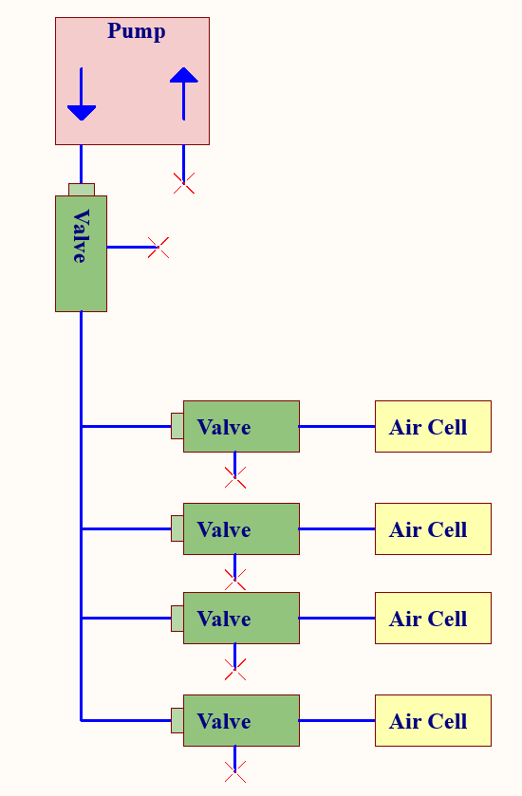
Air Flow System
Power to the valves changes direction of airflow
Allows for air cells to be individually inflated/deflated
Extra valve for extra air flow when exhausting air

Slide 8
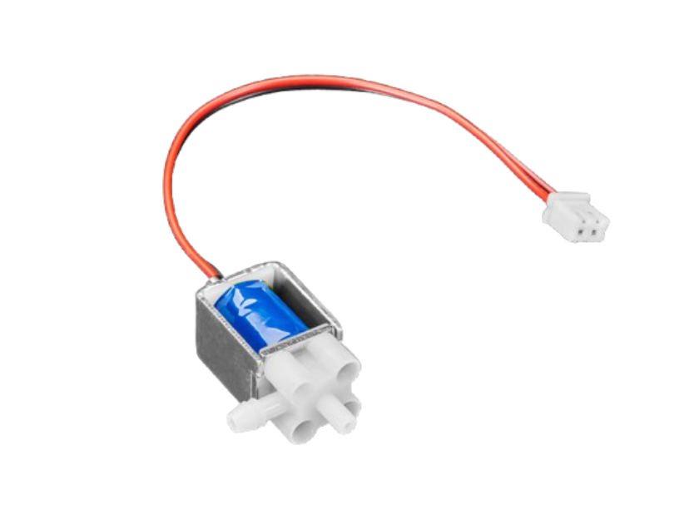
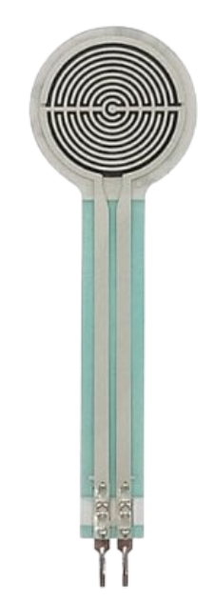
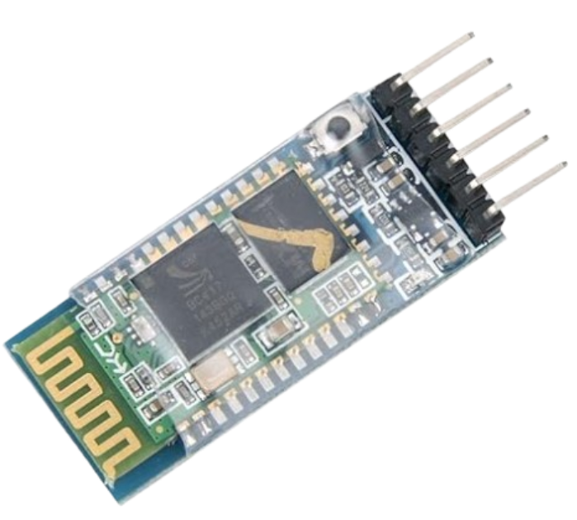
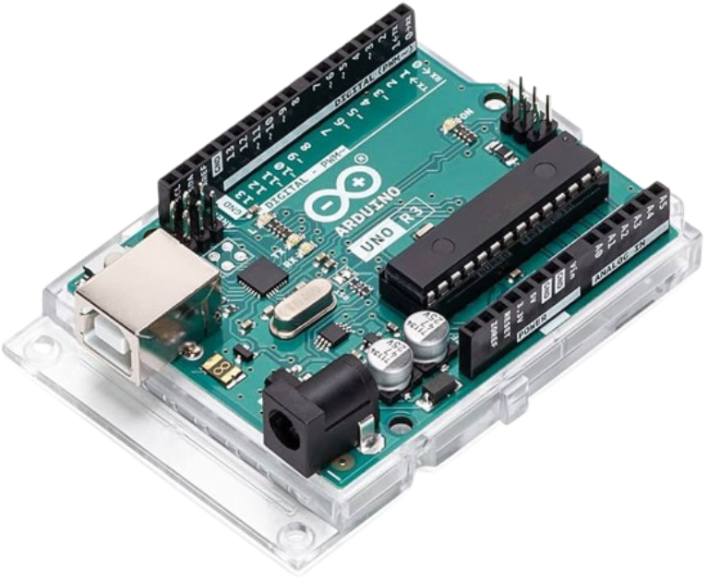
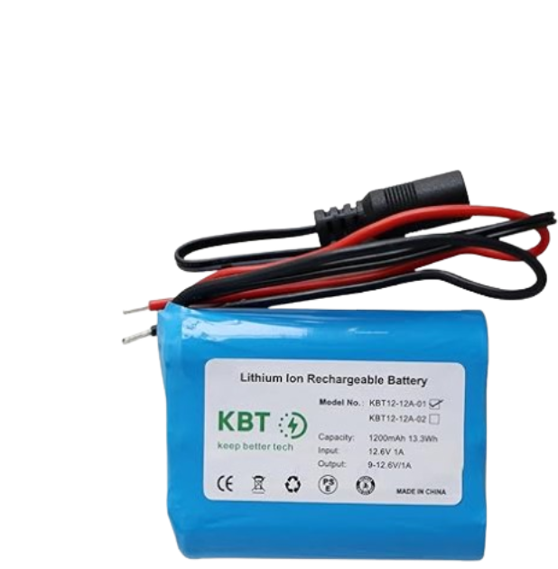
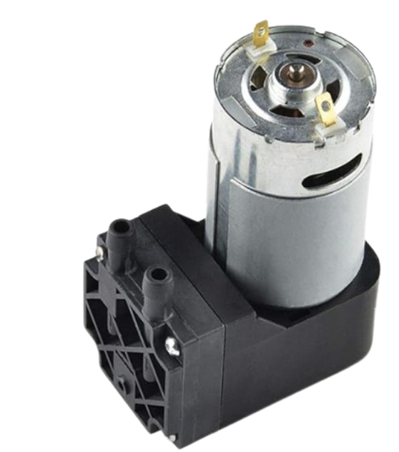
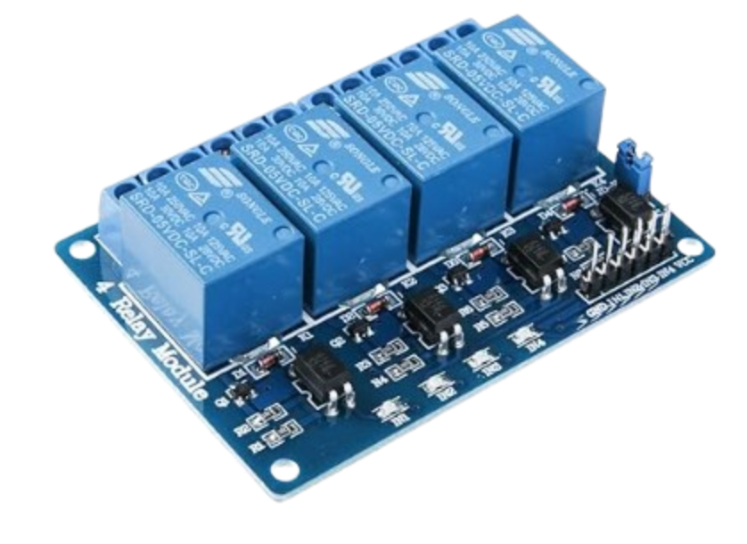
Electrical Components Used
Valves
Pressure sensors
BLE Bluetooth Module
Arduino Uno
Air Pump
Rechargeable Battery
Relay Module

Slide 9
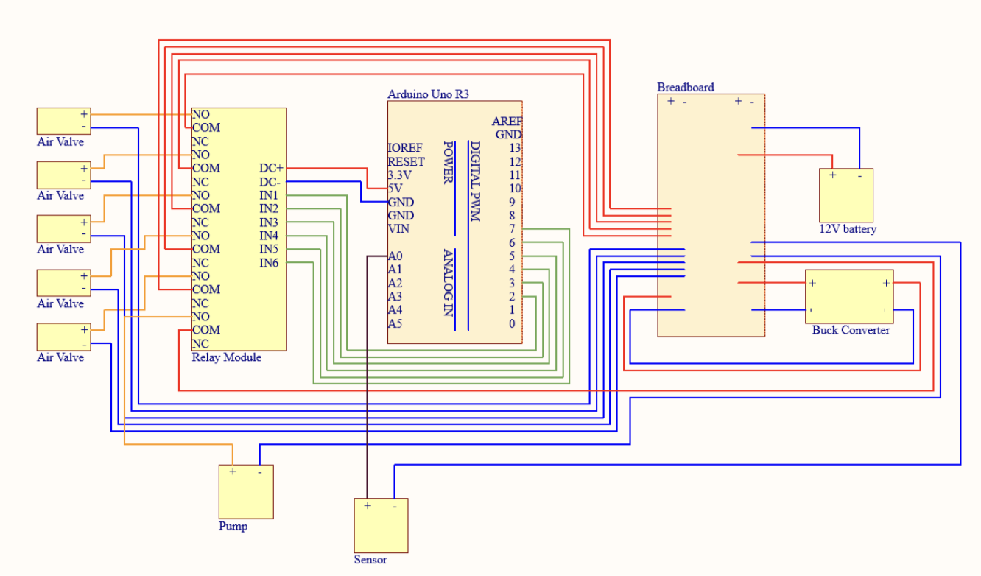
Electrical Overview
Arduino controls pump and valves to adjust air cells.
Relay module manages individual valve activation.
Pressure sensor provides real-time feedback.
Powered by 12V battery with buck converter.

Slide 10


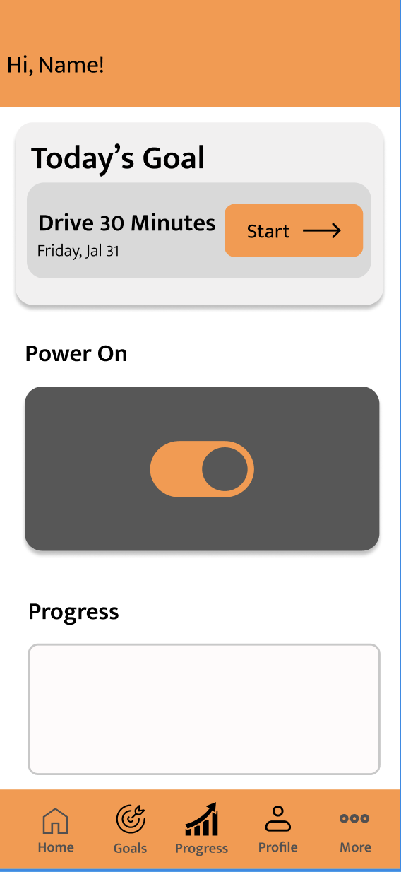


Software/App Overview
Developed using React Native, which is a cross platform compatible app development library.
BLE integration with react-native-ble-plx and react-native-ble-manager libraries.
Demo on the next slide!
Design
Implementation
Notes:
The implementation logos are React, React Native, and Expo.

Slide 11
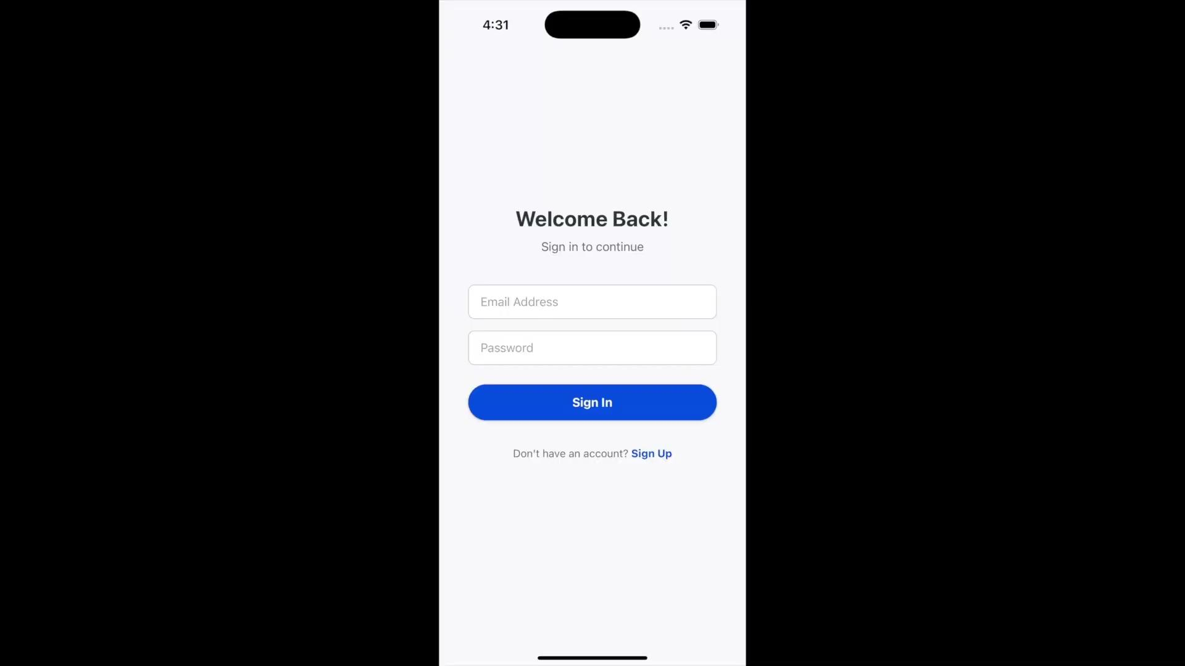
Software/App Overview

Slide 12
App Key Features
User account creation through Firebase
Log and track posture goals
Remotely power the device on/off
Email reminders and stats about user posture settings
Monitor exact pressure values from the hardware, monitor pressure

Slide 13
Next Steps
Lessons Learned
Mechanical
Redesign the back of the fabric to allow for better wire management to make the product as seamless as possible
Using thinner tubes for easier tube management inside the fabric
Creating different sizes of Back Buddy to accommodate more people and different types of chairs
Electrical/Software
Clean up wiring
Utilize bluetooth module to communicate between the product and the app
Incorporate additional sensors to enhance the data from Back Buddy
Add more air pumps for more precise control
Increasing the scope of testing to different scenarios
Assemble the product as soon as each of the individual components are tested
Achieve the attainable goals first before trying to get to the reach goals to ensure functionality first
Cross-disciplinary collaboration is powerful :)

